Slide 1
Family History Center 24th Annual Genealogy Workshop
Genealogy Around the World
Global Harvest: Conducting Effective, Fruitful Interviews on Zoom or in Person
By Mary B. Johnston
Personal historian
wordworksstories@gmail.com www.tell-your-stories.com 843-327-1835

Slide 2
1. Prepare the interviewee
for the interview.
You will increase the richness, emotionality, and complexity of a person’s memories if you provide brain-priming activities ahead of time.

Slide 3
2. Prepare yourself for the interview.
Have your planned questions at hand. Jot down follow-up questions that come to mind as the interviewee speaks. Pursue these when appropriate.
Remember that the objective of the interview is to elicit information from the narrator, not to correct, debate or educate. Your role is to serve as an alert, helpful questioner and your purpose is to strive for a narrator monologue. The interview is not a dialogue. It is a one-sided conversation.

Slide 4
3. A calm, emotionally safe atmosphere is conducive to remembering. Showing indications of attunement is also helpful.
Notes:
Make sure you are calm. Test your equipment ahead of time, have everything you need in your bag, arrive on time, turn off your cell phone, choose a location for the interview where there will be no interruptions or distractions.
Calming the interviewee. Begin with a casual, warm exchange. Once you are both settled, match the interviewee’s breathing.
Using body language that communicates attention and acceptance:
comfortable eye contact
indications of careful listening: head nodding, affirmative sounds, leaning forward, relaxed and open body posture, etc.
ii. Using affirming emotional language that communicates
openness
acceptance
curiosity and interest
Encourage the narrator with facial expressions and occasional short verbal responses, i.e., "Ummm," "Interesting," "Go on."

Slide 5
4. Think carefully about your questions and the order in which you ask them. Begin with factual, non-threatening questions. Save emotional, difficult, touchy or controversial questions for later in the interview after rapport and trust have been established.

Slide 6
Understanding the Unique Functions of the Left and Right Hemispheres Can Help You Choose Which Questions to Start With
Hemisphere | Specialization | Types of questions | Possible format
Left | * Linear * Logical * Language | Facts and explanations (i.e., What kind of work did your parents do? Why did your family move in 1940?) | *Questionnaire sent to client ahead of time
Right | *Emotions *Spatial orientation *Sensory memories (e.g., food, music, clothes) | feelings, descriptions, sensory details (i.e., How did it feel to leave your childhood home? What foods do you remember enjoying as a child?) | *Interview questions *Memory cards

Slide 7
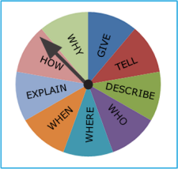
5. Ask open-ended questions, not questions that can be answered with a simple "yes" or "no” or other one-word responses. This is true even when you are appealing to the left brain.

Slide 8
6. Questions should be simple, brief, and singular.
Notes:
Resist the temptation to rephrase your questions in a variety of ways.
Allow silence.

Slide 9
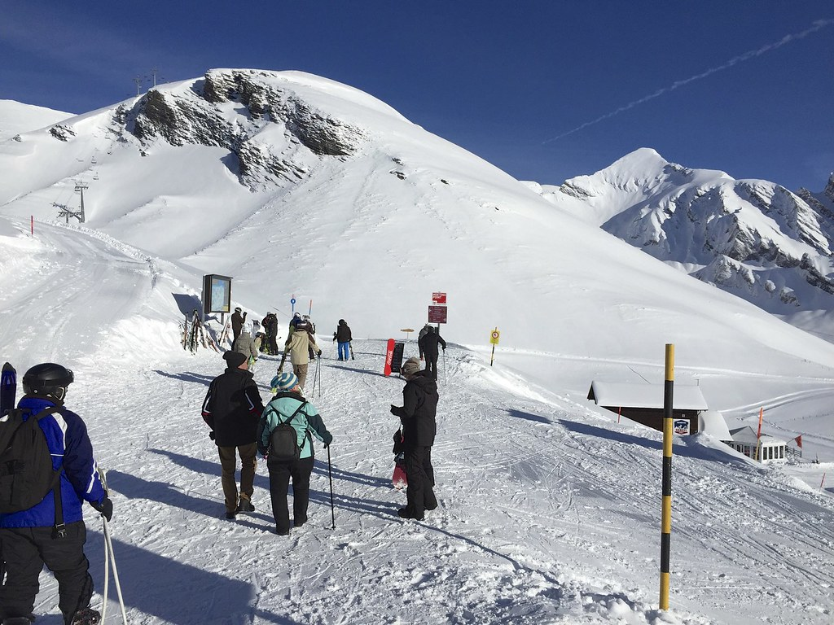
a. Refer to specific events.
7. Because memories are associative and multilayered, you need to use a variety of approaches to accessing them.

Slide 10
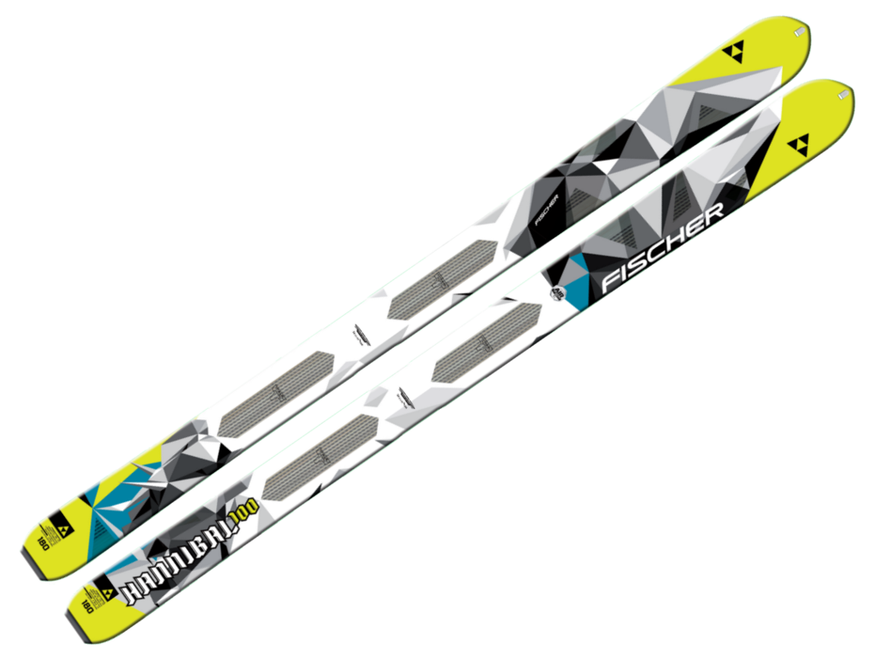
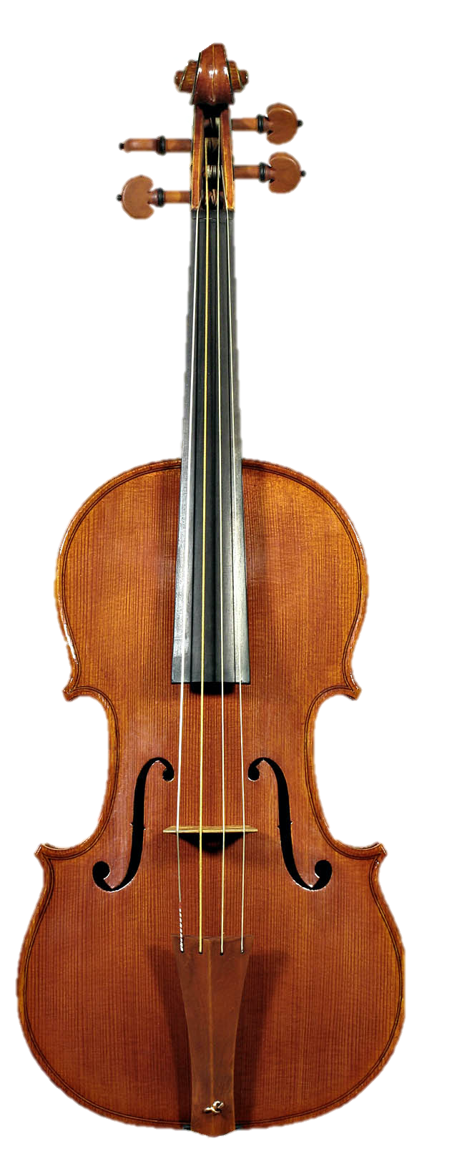
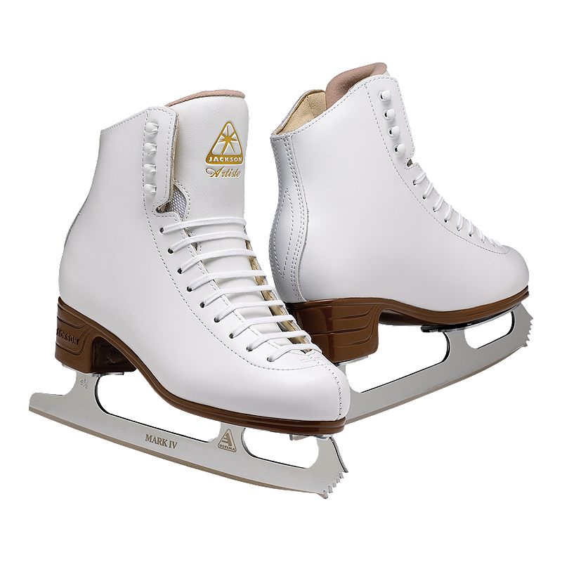
7b. Because memories are encoded through our sense, use a variety of props—photos, furniture, artifacts, newspaper clippings, music, food.

Slide 11
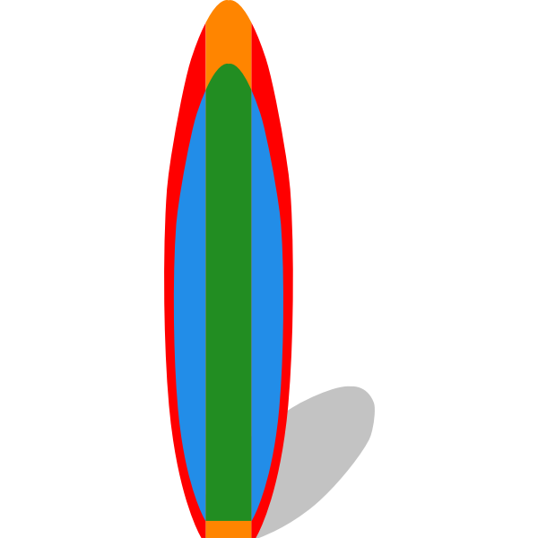
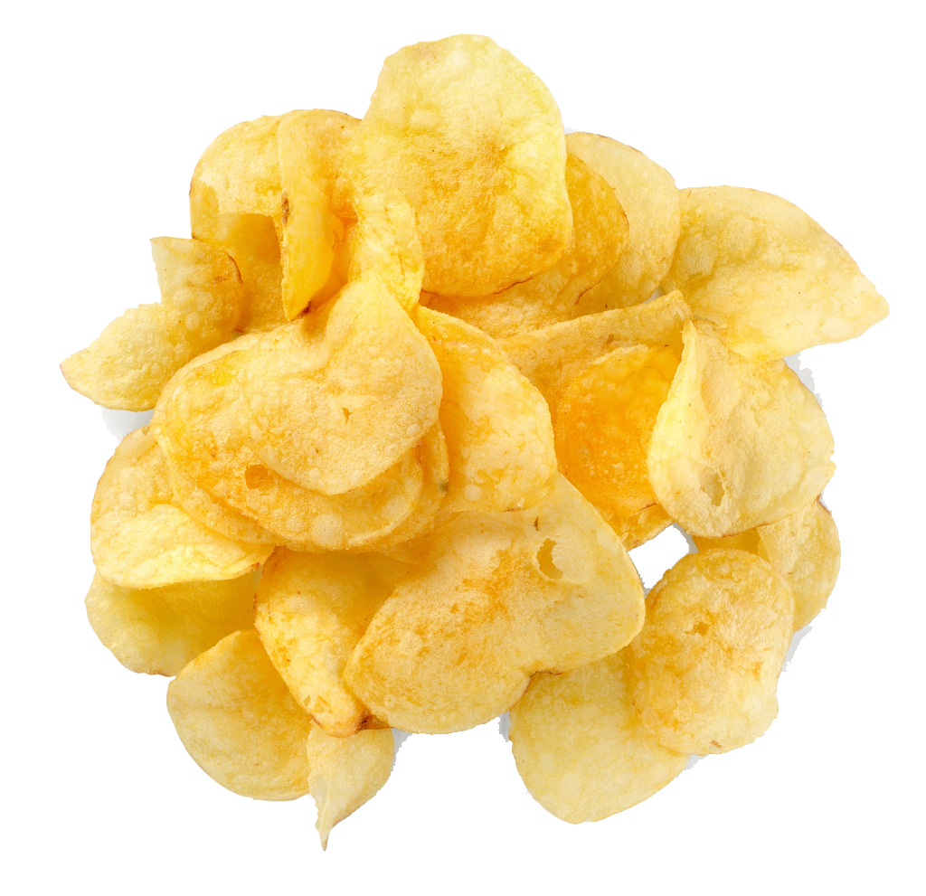
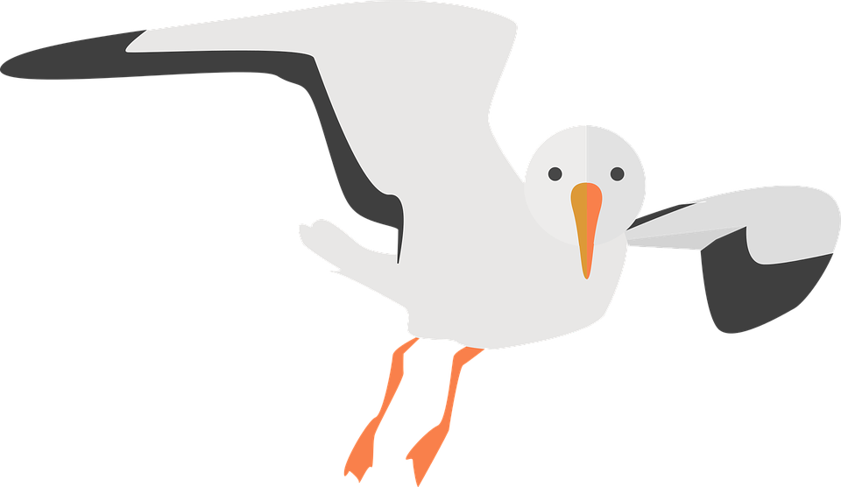
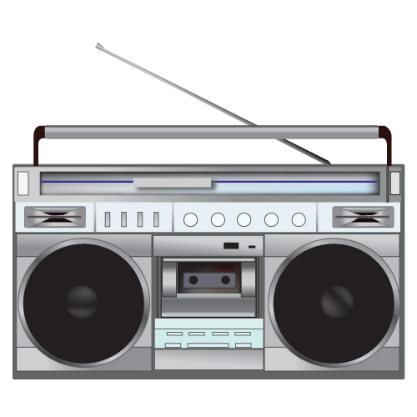
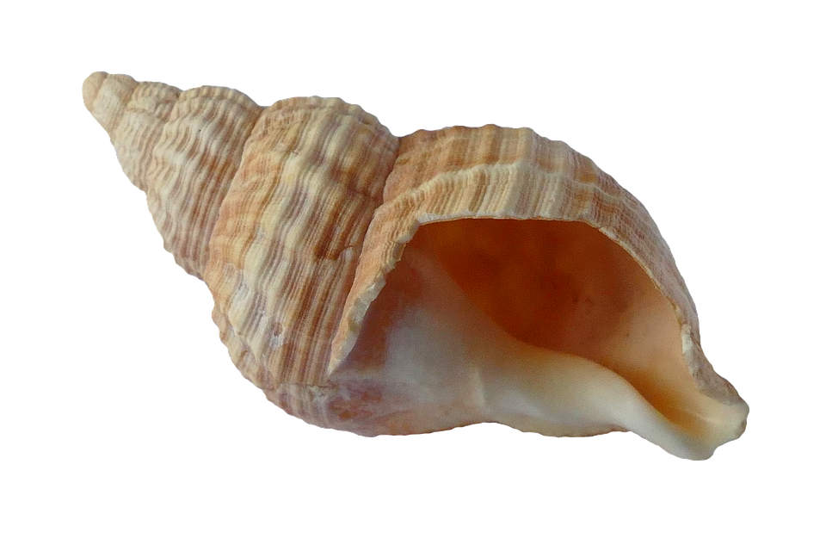
7c. Ask the narrator to reconstruct the scene or situation—again by appealing to a variety of senses.
Notes:
Ask them to refer to the “Sensational” Memory exercise

Slide 12
7d. Once the details of the event are clear only then ask about emotions at the time. Consider following up with reflections about the event now, in retrospect.

Slide 13
Interview Faux Pas
Not testing your recording equipment ahead of time
Interrupting your interviewee
Asking leading questions such as “Do you think the career you chose was hard on your family?”
Being distracted
Not looking at the speaker
Talking about yourself
Letting your speaker go on tangents that are not related to the intended purpose

